Slide 1



TASK 2 | Mentorness Data Analytics Internship
COVID-19 Analysis using SQL
Christian Nico Gayo
MIP-DA-07

Slide 2

Overview
COVID-19, caused by the novel coronavirus SARS-CoV-2, spreads primarily through respiratory droplets and can result in severe respiratory illness (WHO, 2020). Declared a pandemic by the WHO in March 2020 (WHO, 2020), it has caused widespread illness, mortality, and significant socioeconomic disruption worldwide. Efforts to combat it have included vaccination campaigns, social distancing measures, and public health initiatives to mitigate transmission.

Slide 3
Overview
Data and data analysis have played pivotal roles in understanding the spread of the virus, guiding public health responses, and informing policy decisions. Epidemiological data, such as case counts, transmission rates, and demographic information, provide insights into the dynamics of the pandemic (Johns Hopkins University, 2020). Additionally, genomic sequencing helps track the evolution of the virus and detect variants of concern, aiding in vaccine development and deployment strategies (CDC, 2021). Accessible, accurate, and timely data is crucial for effective pandemic management and shaping evidence-based interventions.

Slide 4

Task Overview
The COVID-19 pandemic has had a significant impact on public health and has created an urgent need for data-driven insights to understand the spread of the virus.
As data analysts, deriving meaningful insights and presenting findings is a way to contribute in understanding the dynamics of the virus and eventually, partaking in the development of data-driven decisions for health organizations and relevant decision making bodies.

Slide 5

COVID-19 Analysis using SQL
Dataset Exploration
Christian Nico Gayo
MIP-DA-07

Slide 6
PROVINCE
DATE
Geographic subdivision within a country/region.
Recorded date of COVID-19 data.
Columns
in the
Dataset
COUNTRY/REGION
CONFIRMED
Geographic entity where data is recorded.
Number of diagnosed COVID-19 cases.
LATITUDE
DEATHS
North-south position on Earth's surface.
Number of COVID-19-related deaths.
LONGITUDE
RECOVERED
East-west position on Earth's surface.
Number of recovered covid-19 cases.

Slide 7
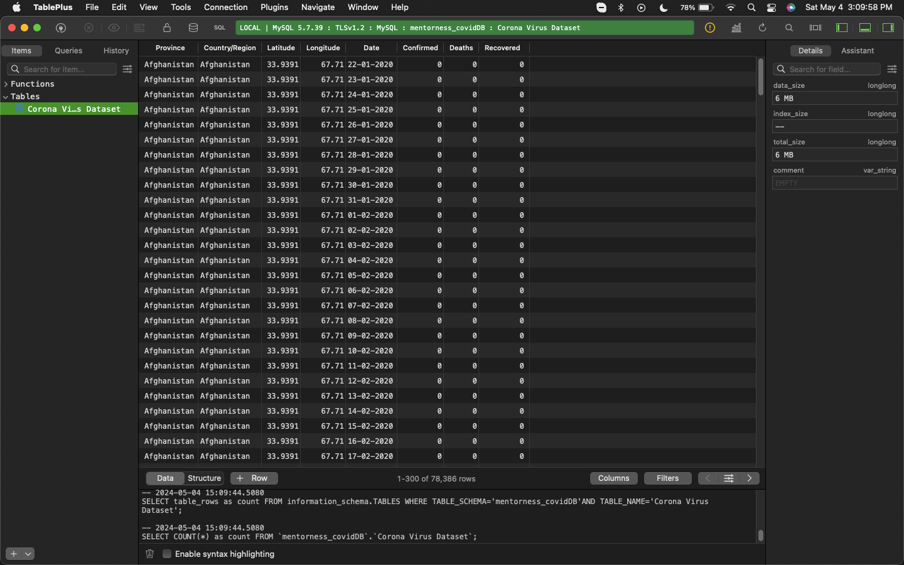
Sample Data from the Dataset

Slide 8

COVID-19 Analysis using SQL
Data
Preparation
Christian Nico Gayo
MIP-DA-07

Slide 9



TablePlus for database creation, access, and querying
MAMP for localhosting
Wash hands with soap and water or sanitize hands with alcohol before wearing a face mask.
Do not touch the face mask while using it. Wash or sanitize hands immediately when you accidentally touched it.
SQL (MySQL) as the primary language for querying
Ensure the nose, mouth, and chin are fully covered. There should be no gaps at the edges of the face mask.

Slide 10



Date formatting issue

Slide 11
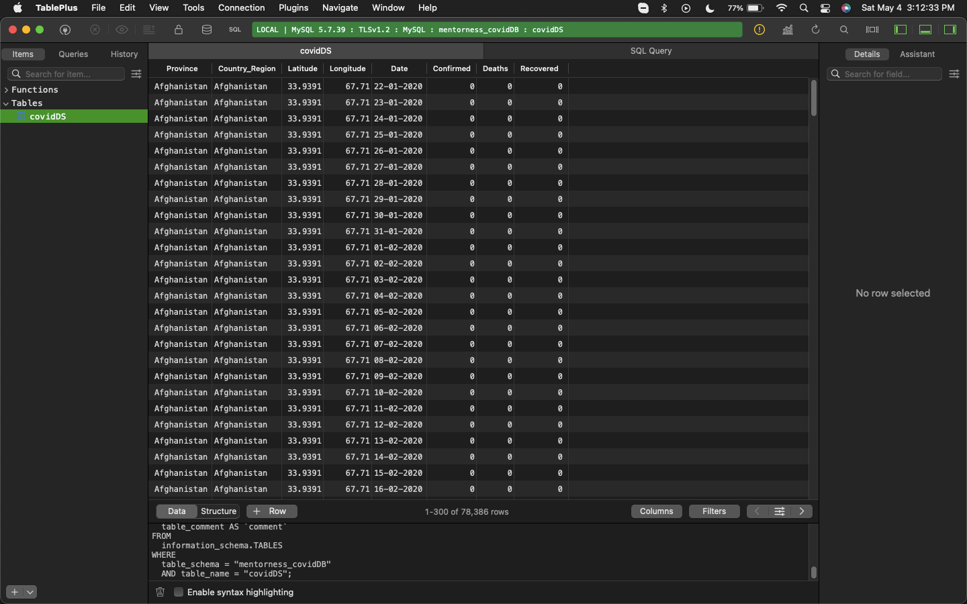
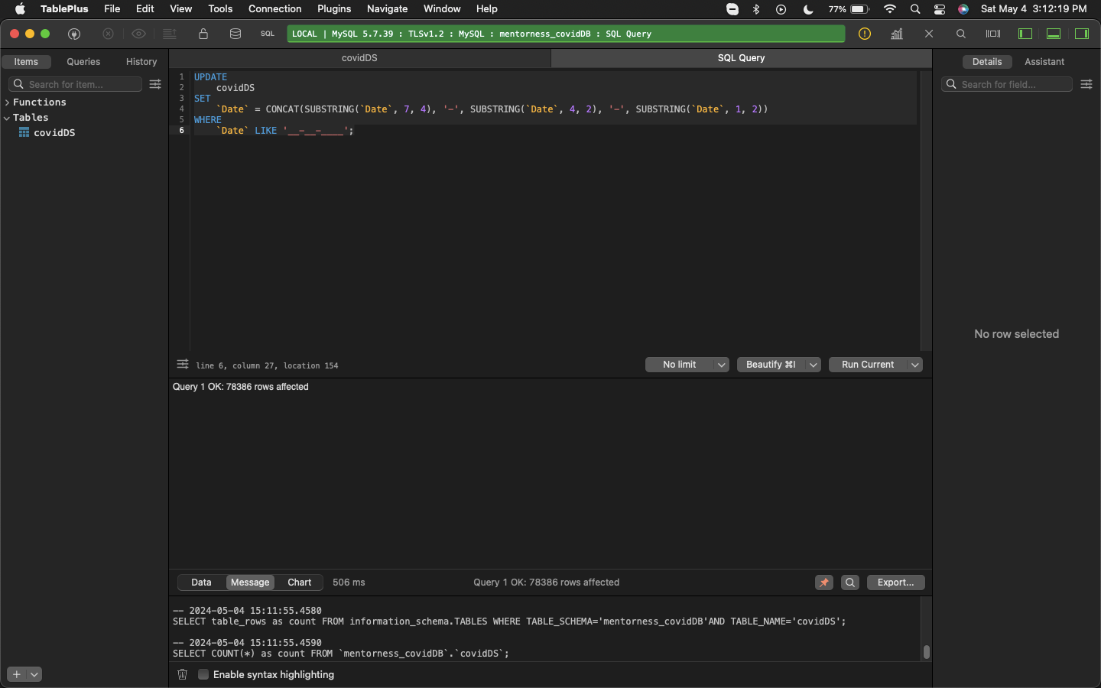
Results after executing UPDATE query

Slide 12

COVID-19 Analysis using SQL
Data
Exploration
Christian Nico Gayo
MIP-DA-07

Slide 13



Q1. Write SQL query to check for NULL values.

Slide 14
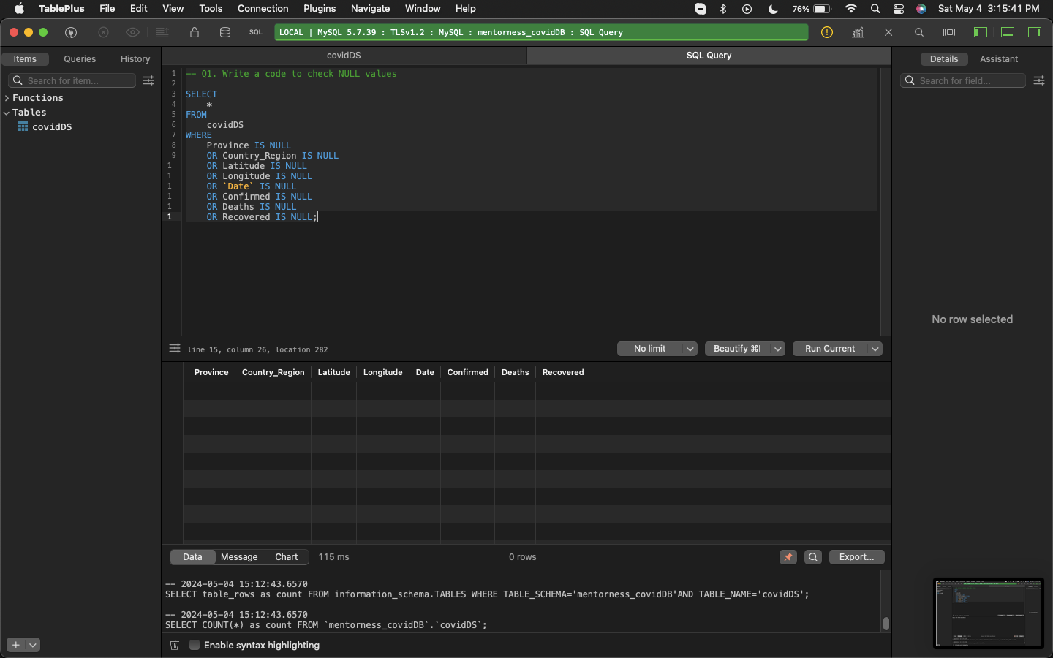
No NULL records.
There are no NULL records contained within the dataset.

Slide 15
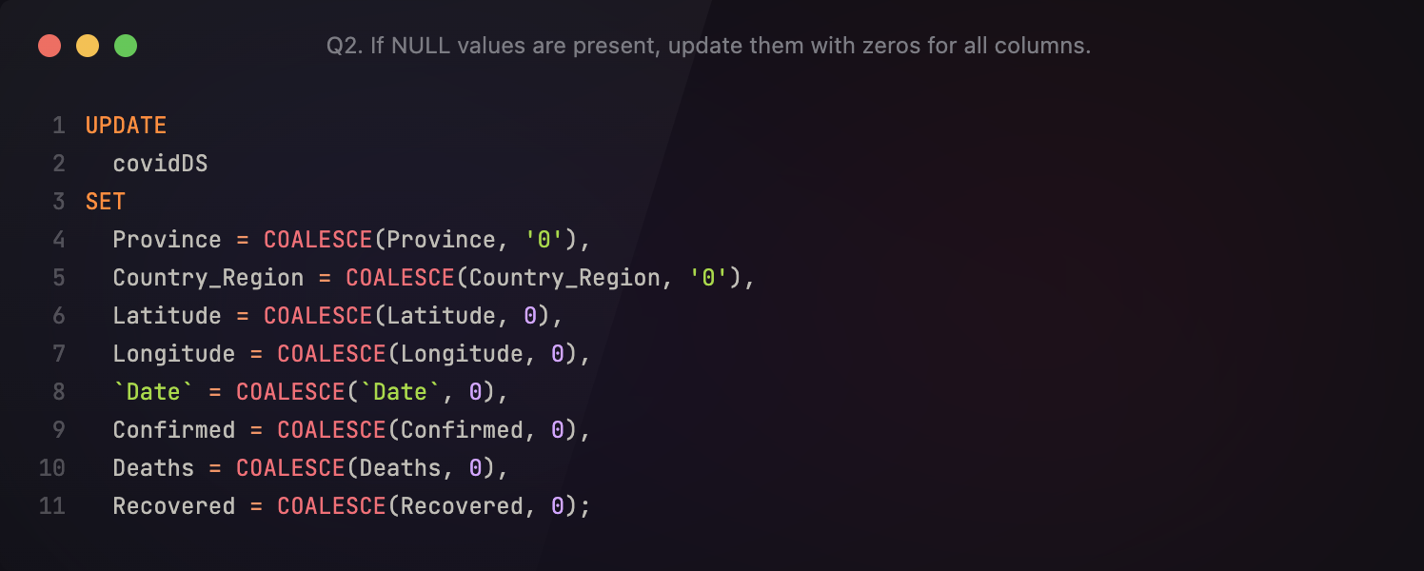
Q2. If NULL values are present, update them with zeros for all columns.

Slide 16
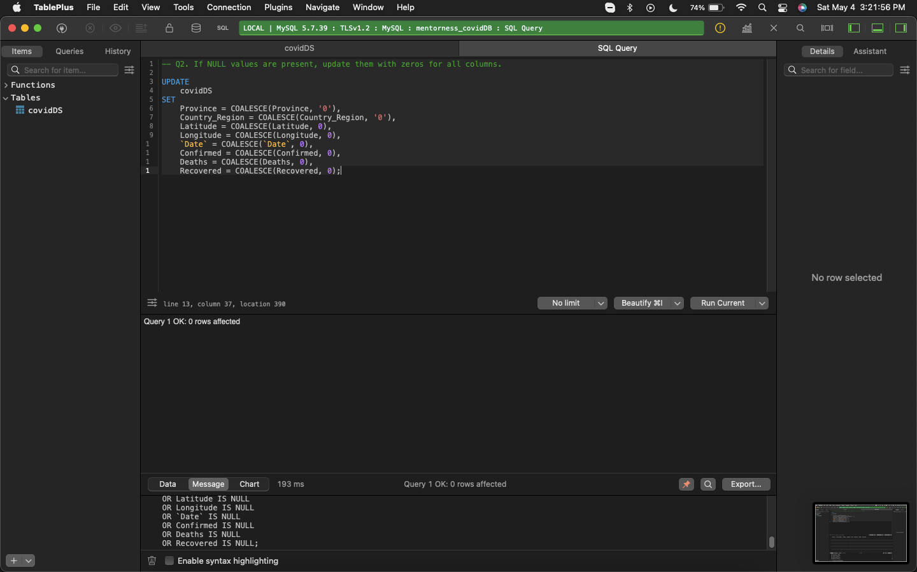
No NULL records, using COALESCE to make sure.
NULL values are not present in the dataset. However, for good measure, a query will be run to set NULL values to zero using the COALESCE keyword.

Slide 17

Q3. Check for the total number of rows.

Slide 18
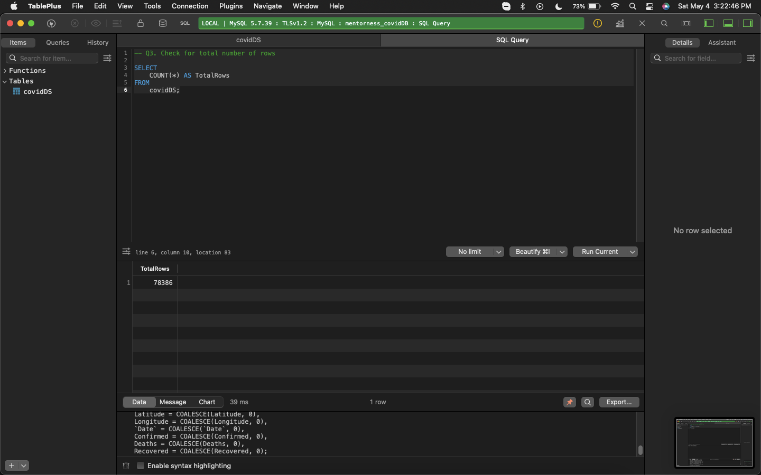
78,386 rows/records found!
There is a total of 78, 386 rows or records contained in the dataset.

Slide 19

Q4. Check what is start_date and end_date.

Slide 20
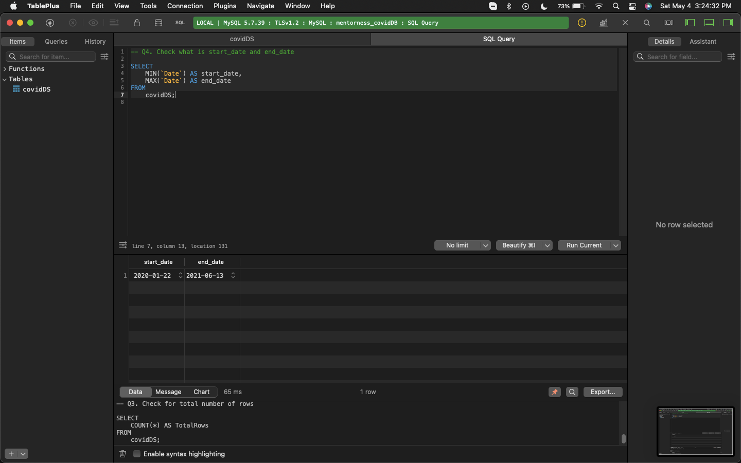
From January 2020 to June 2021.
Records of the dataset span from January 1, 2020 to June 13, 2021.

Slide 21

Q5. Find the number of months present in dataset.

Slide 22
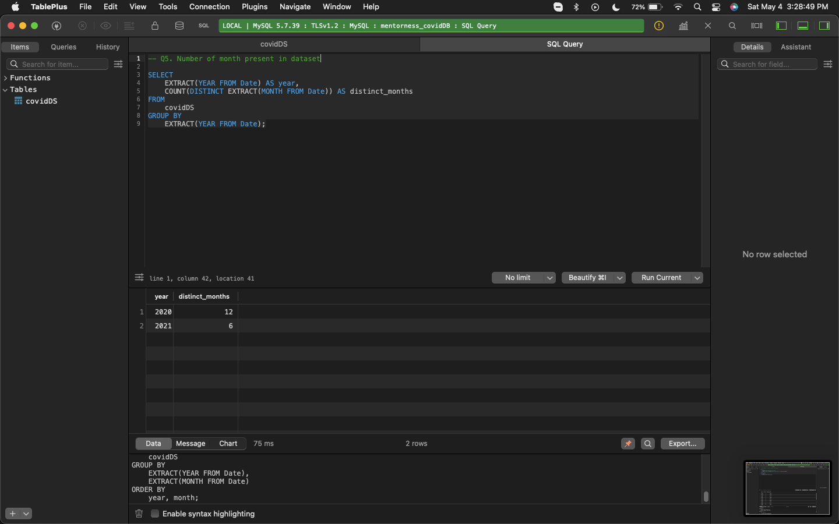
18 distinct months.
Since the dataset spans from January 1st of 2020 to the 13th of June of 2021, there are eighteen (18) distinct months contained in the dataset. Twelve (12) of them belong to the year 2020 and six (6) are under the year 2021.

Slide 23
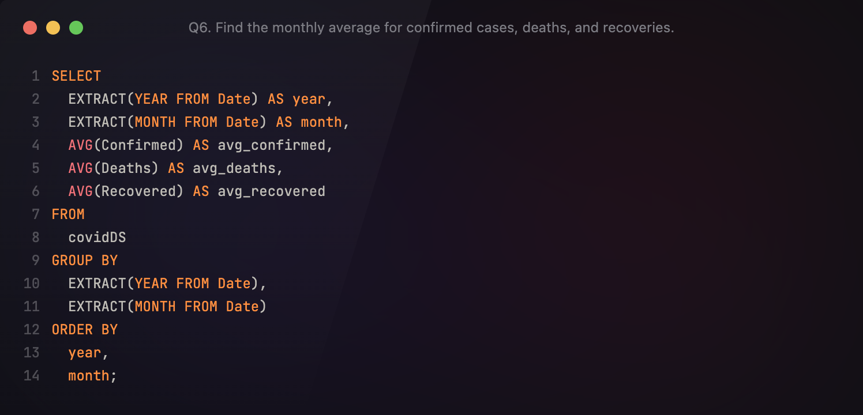
Q6. Find the monthly average for confirmed cases, deaths, and recoveries.

Slide 24
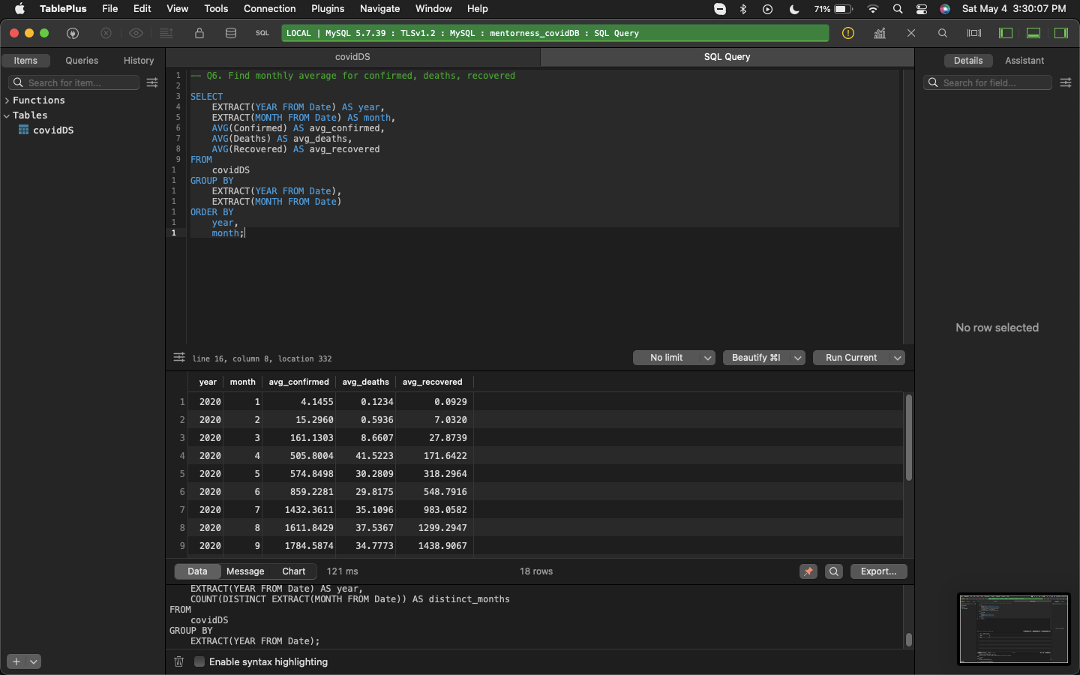
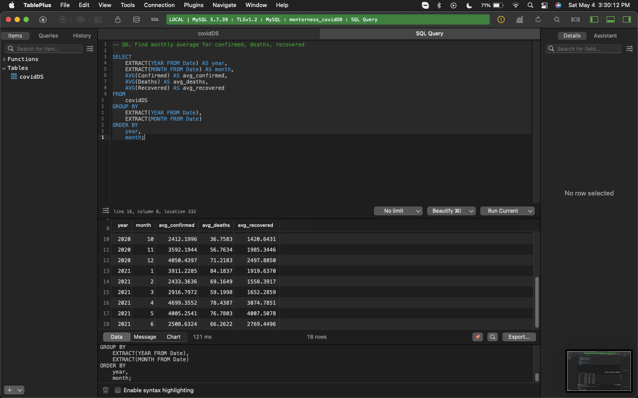
As time moved forwards, average cases, deaths, and recoveries increased.
1) Highest average confirmed cases by April 2021, highest average death by January 2021, and highest average recovered by May 2021.

Slide 25
2) It is evident from the dataset that as time progressed, there is an increase in average confirmed cases, average deaths, and average recovered.
3) Eventual decline of average confirmed cases by January 2021 with a spike by April 2021.

Slide 26
4) Eventual decline of average deaths by February 2021.
5) Increased average recovered means mitigation procedures implemented by governing bodies have taken effect, reducing further spreading of the virus.

Slide 27

Q7. Find the most frequent value for confirmed cases, deaths, and recoveries for each month.

Slide 28
Q7. Find the most frequent value for confirmed cases, deaths, and recoveries for each month.

Slide 29
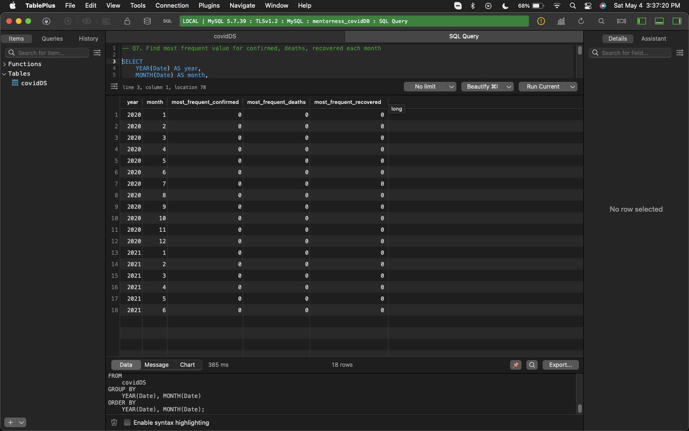
Zero is the most frequent value.
Zero is the most frequent number appearing for all records of confirmed cases, deaths, and recovered, and spanning through all of the months contained in the dataset.

Slide 30
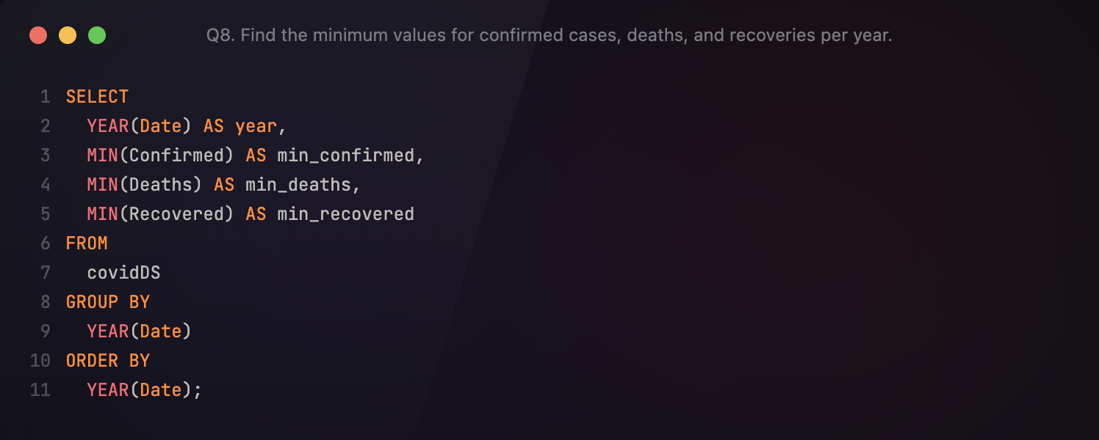
Q8. Find the minimum values for confirmed cases, deaths, and recoveries per year.

Slide 31
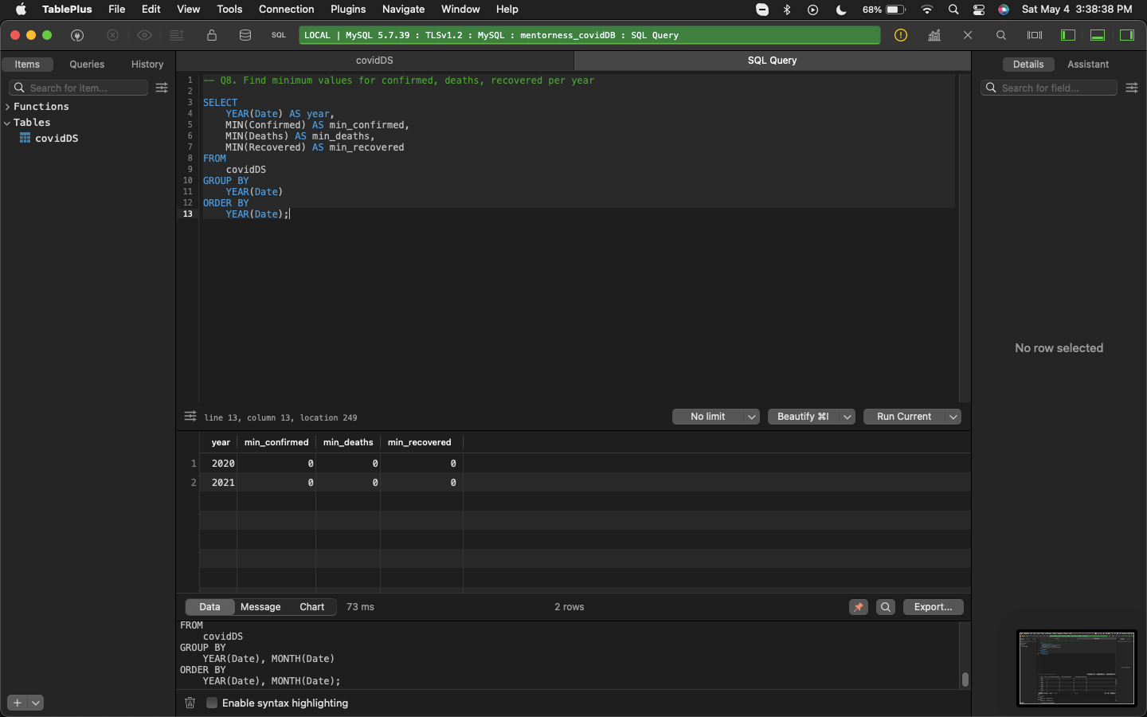
Zero is the minimum.
Zero appears as the minimum recorded value for confirmed cases, deaths, and recoveries throughout the years included in the dataset.

Slide 32
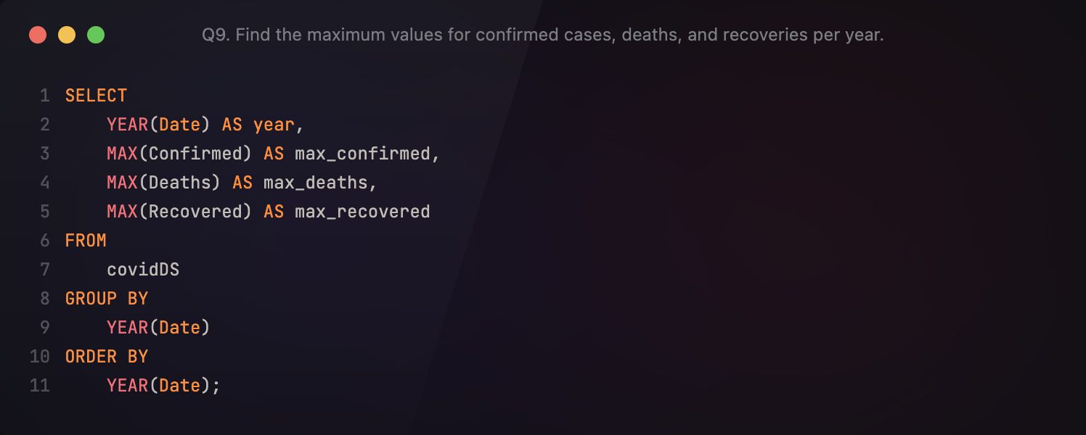
Q9. Find the maximum values for confirmed cases, deaths, and recoveries per year.

Slide 33

2020 is for confirmed and recovered, 2021 is for deaths.
With the abundance of records, 2020 holds the record for having the most confirmed cases and most number of recovered.
Interestingly, 2021 holds the record for a single instance of most deaths, despite having only 6 months worth of data.

Slide 34
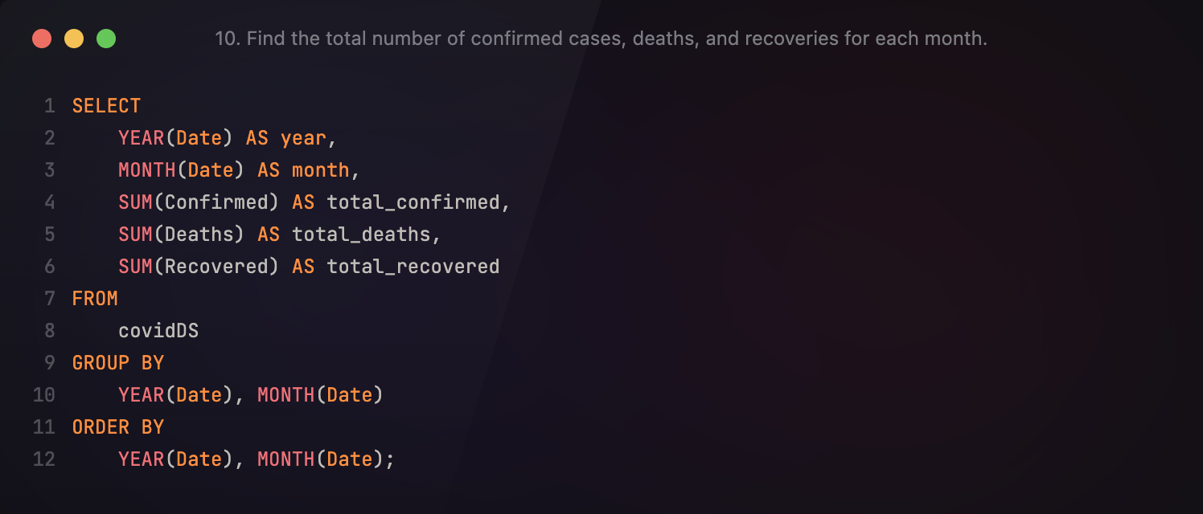
Q10. Find the total number of confirmed cases, deaths, and recoveries for each month.

Slide 35
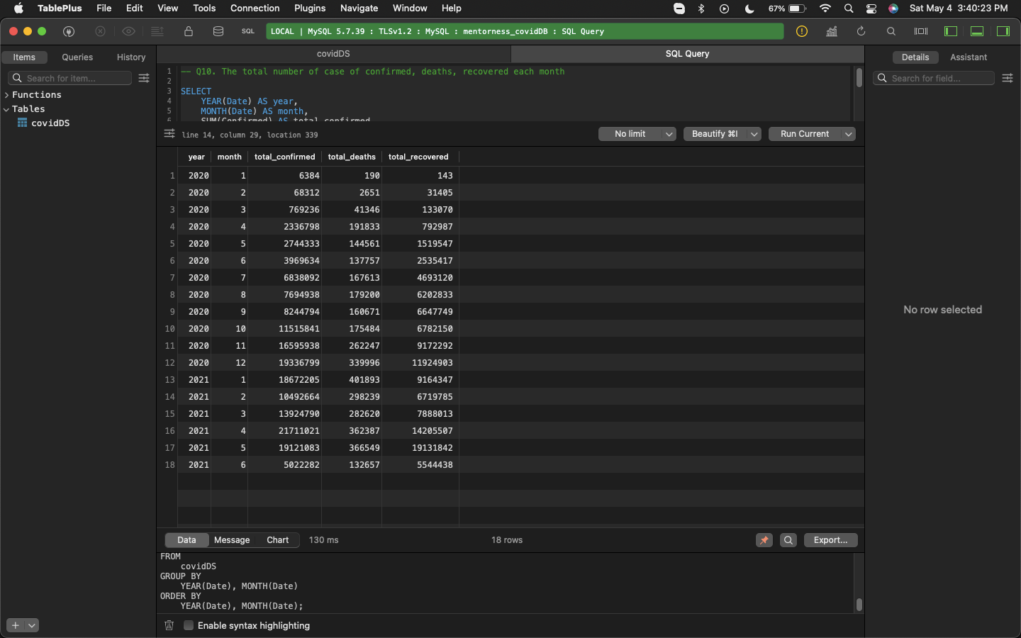
2021 is the year of the highs!
April 2021 has the highest total number of confirmed cases with 21.7M recorded.
January 2021 has the highest total number of deaths with 400k recorded.
May 2021 has the highest total number of recovered with 19.1M recorded.

Slide 36
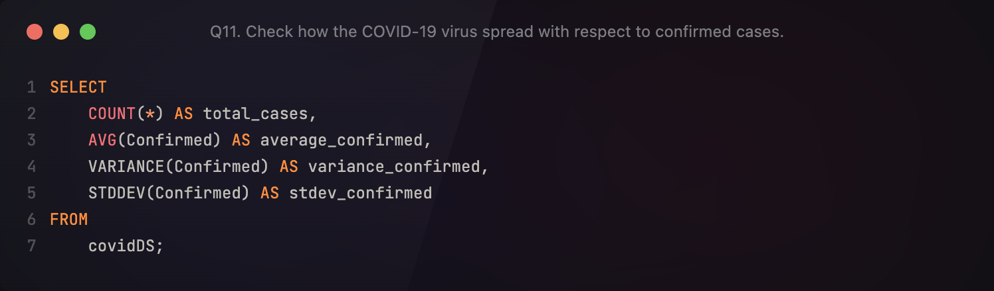
Q11. Check how the COVID-19 virus spread with respect to confirmed cases.

Slide 37
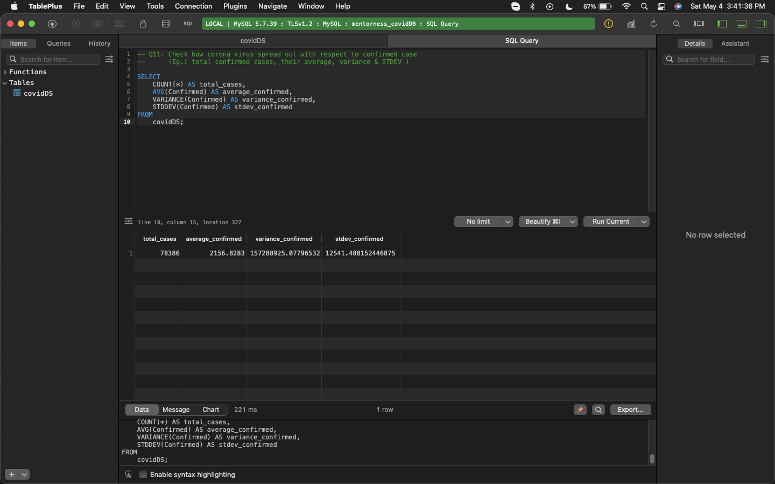
Incredibly high variability and deviation for confirmed cases, which is a bad thing.
The high variance value of 157M indicate that there is an exceedingly high variability of values in the Confirmed column of the dataset.
The standard deviation value at 12, 541 indicates that there is at least a deviation of 12, 541 confirmed cases from the average.

Slide 38
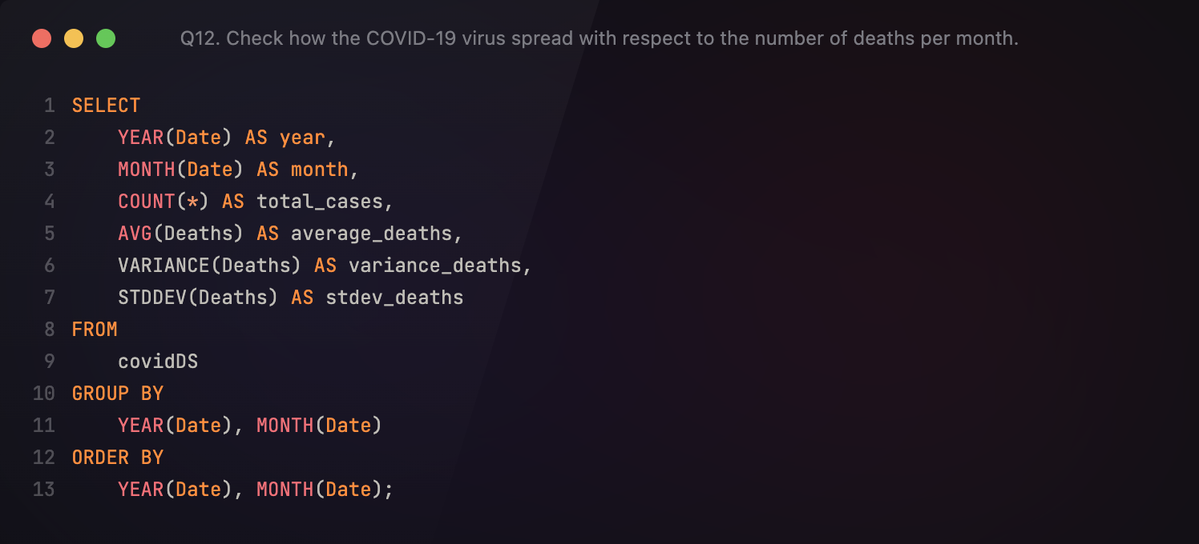
Q12. Check how the COVID-19 virus spread out with respect to the number of deaths per month.

Slide 39
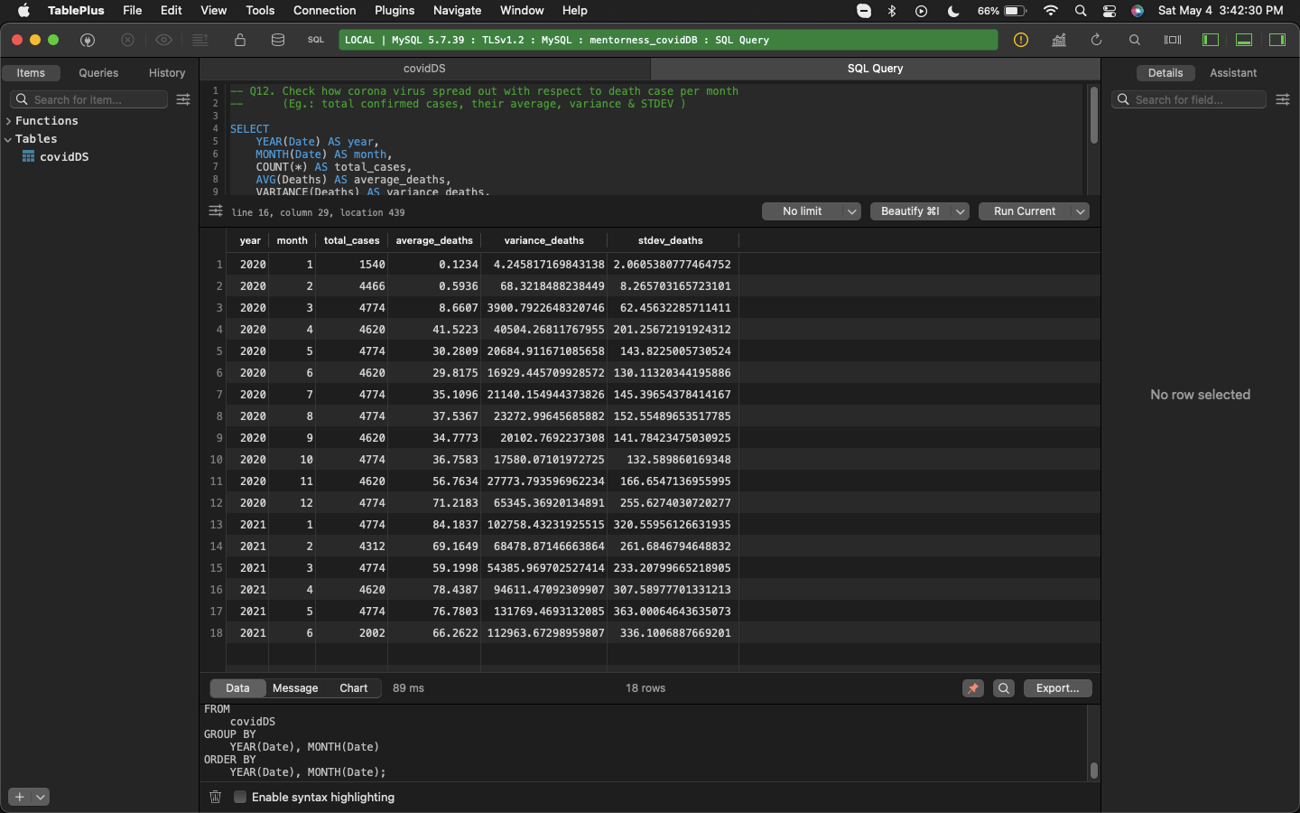
High variability, high deviation in the context of deaths.
There is reasonably high variability and high deviation of values from means in the Death column of the dataset.

Slide 40
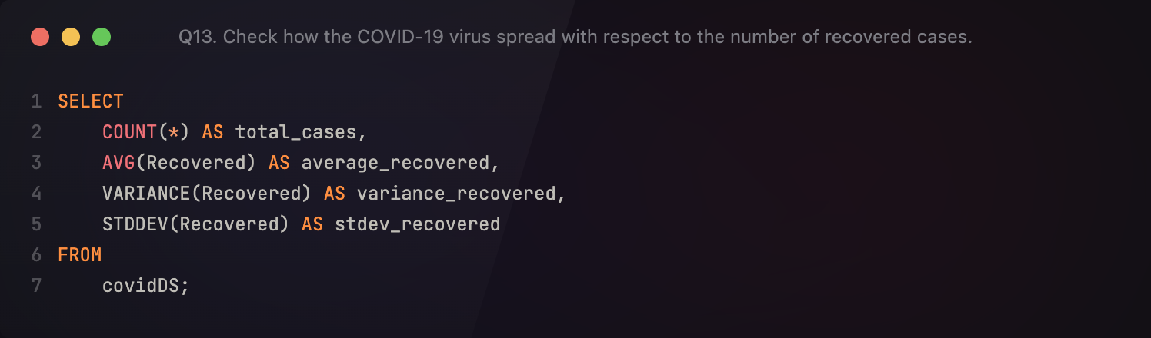
Q13. Check how the COVID-19 virus spread with respect to the number of recovered cases.

Slide 41
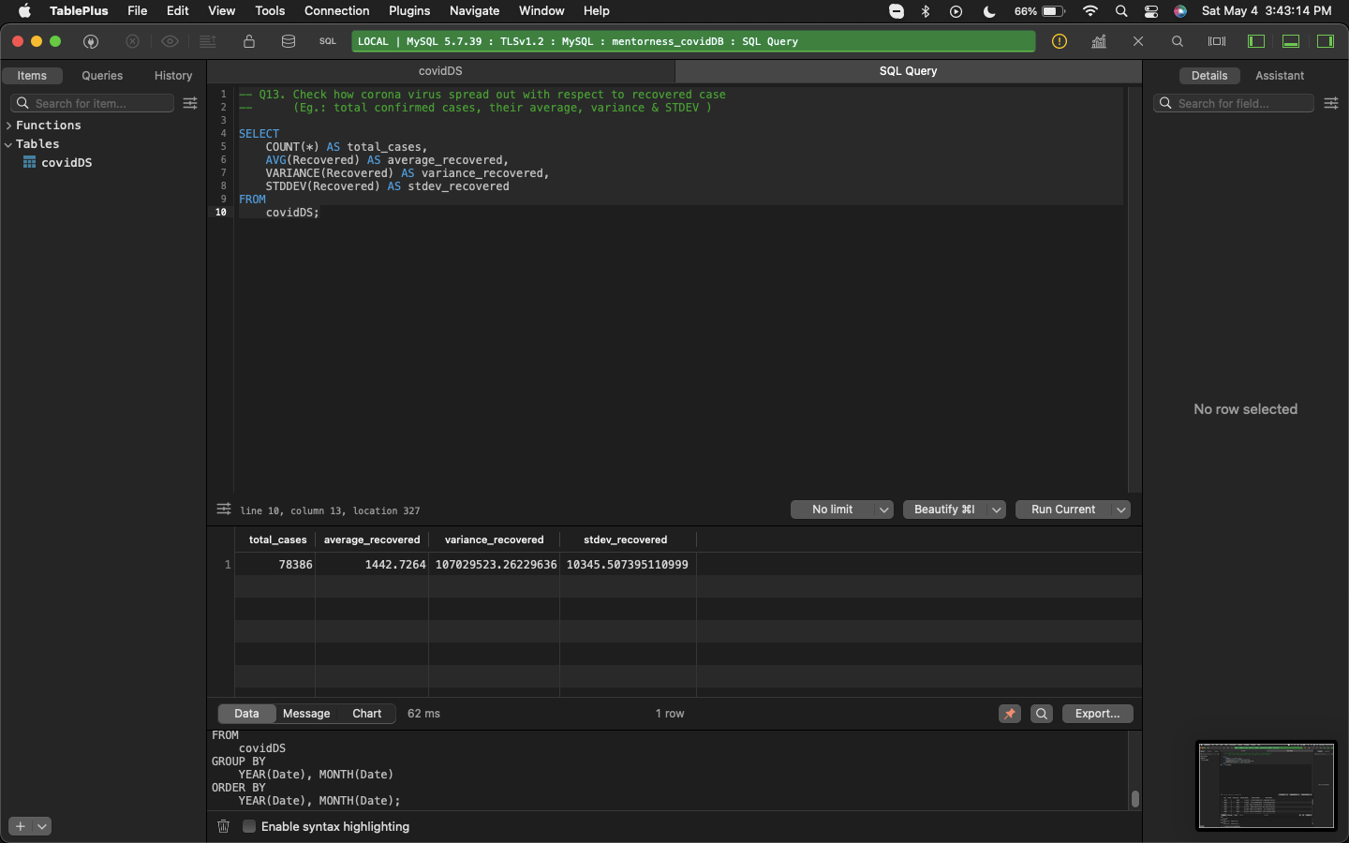
Incredibly high variability and deviation for recovery, which is a good thing.
The high variance value at 107M indicates that there is an incredibly high variability when it comes to the values of the Recovered column in the dataset.
The standard deviation value at 10, 345 indicates that there is at least a deviation of 10, 345 recoveries from the average, which is a good thing.

Slide 42
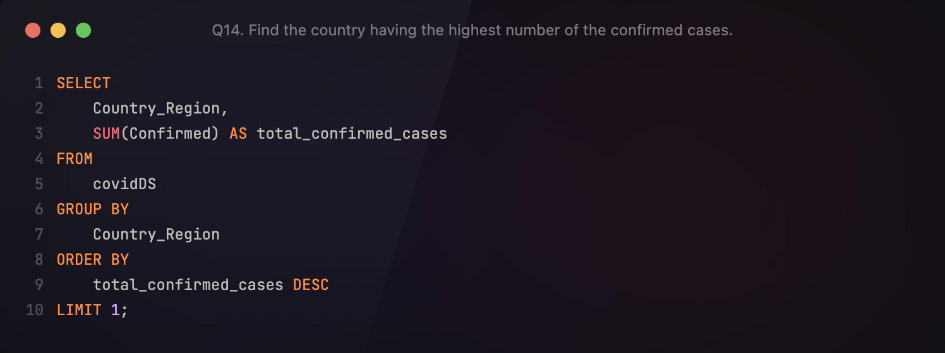
Q14. Find the country having the highest number of the confirmed cases.

Slide 43
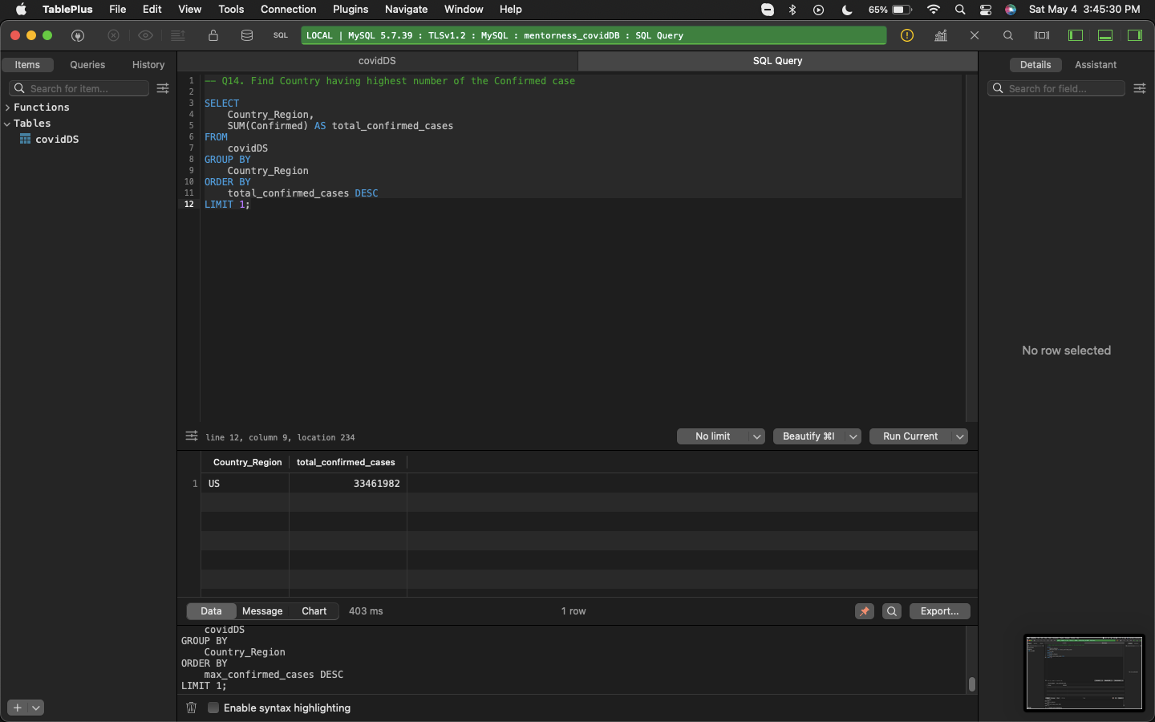
It’s the US!
The United States has a total confirmed COVID-19 cases tally of 33.46M from January 2020 to June 2021!

Slide 44
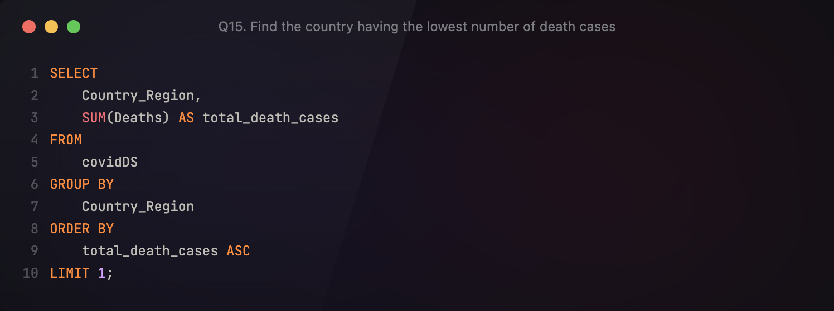
Q15. Find the country having the lowest number of deaths.

Slide 45
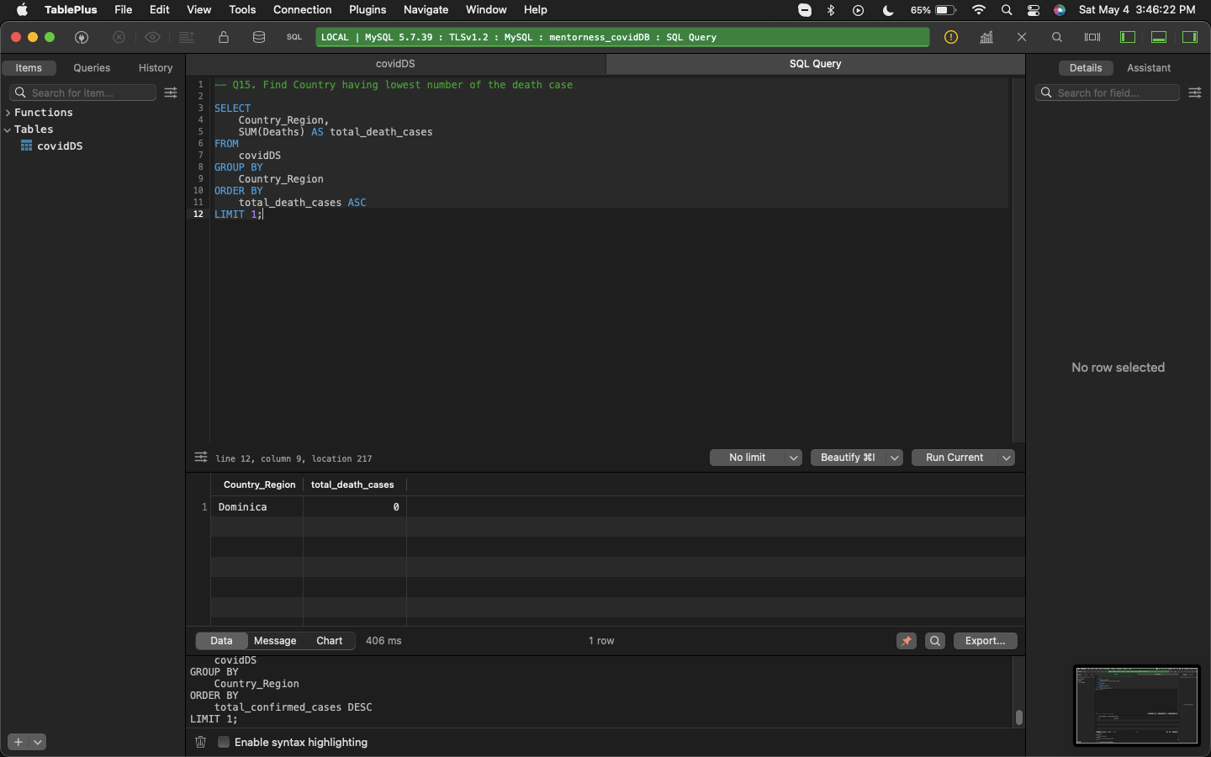
Dominica is dominating the no-deaths chart
Dominica or the Dominican Republic has recorded zero COVID-19-related deaths from January 2020 to June 2021.

Slide 46
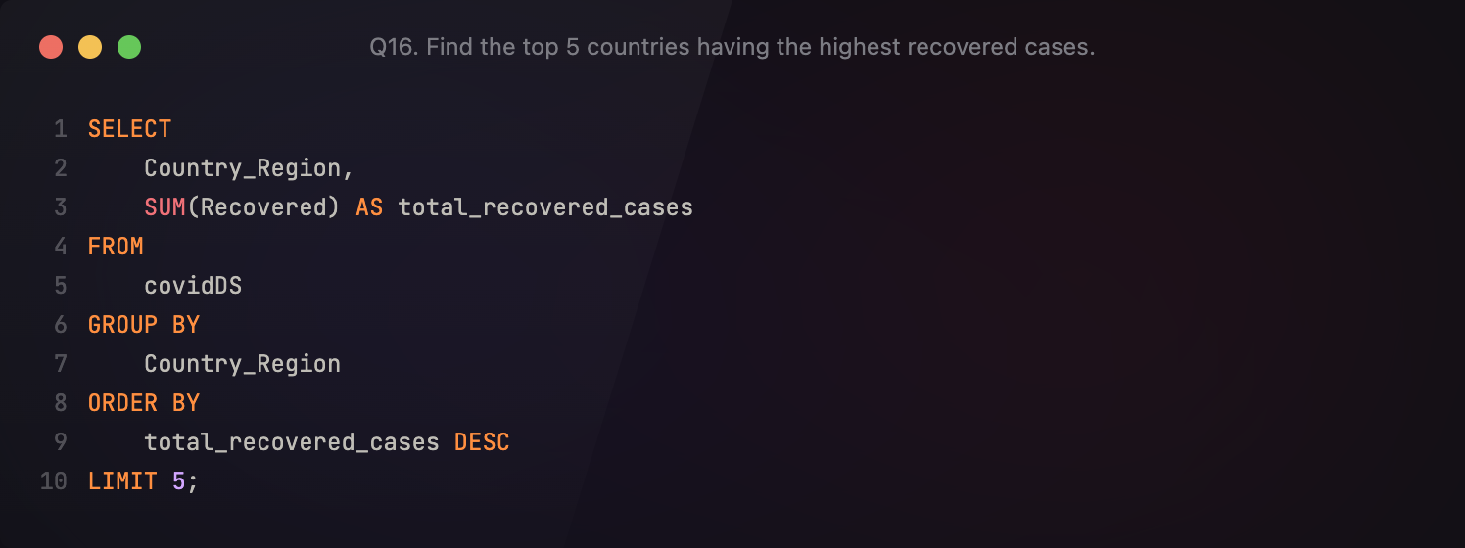
Q16. Find the top 5 countries having the highest recovered cases.

Slide 47
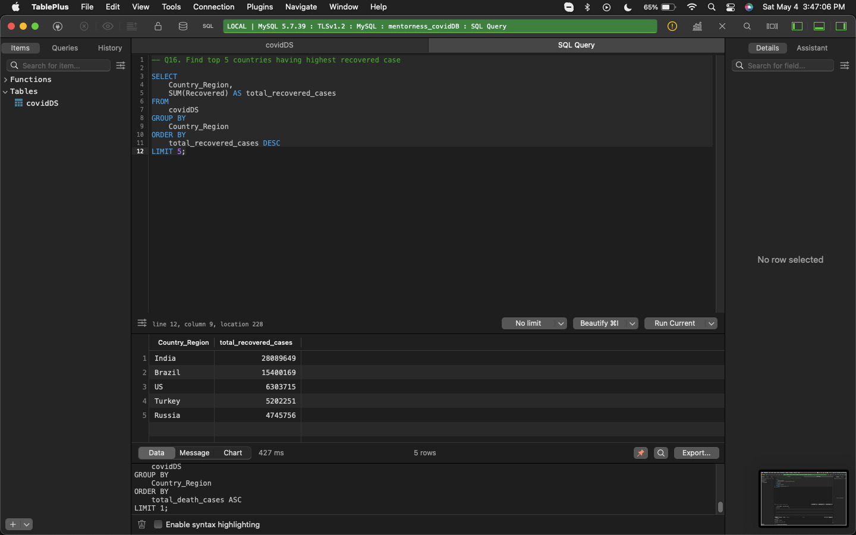
India takes the recovery crown!
India takes the cake in recoveries, having 28M people recover from COVID-19. This is followed by Brazil at 15M, US at 6.3M, Turkey/Turkiye at 5.2M, and Russia at 4.7M.

Slide 48

COVID-19 Analysis using SQL
Conclusions
Christian Nico Gayo
MIP-DA-07

Slide 49





Numbers-wise, the COVID-19 virus has affected an incredibly high number of people, caused significant deaths, and challenged health and governing systems throughout the world.
SQL is effective in managing large amounts of data, and analyzing these data to understand what they mean and imply.
Data analysis can be useful in understanding how certain phenomena occur by understanding the data related to such phenomena.

Slide 50
“Effective data analysis requires more than just mastery of the tools and being able to communicate the results. It requires our understanding that data comes from somewhere, and that every value corresponds to something. How we attach meaning to a number and how we make the world understand that this value has weight defines genuine data analysis.”
Christian Nico Gayo
MIP-DA-07

Slide 51
Citations
World Health Organization. (2020). Coronavirus disease (COVID-19) pandemic. https://www.who.int/emergencies/diseases/novel-coronavirus-2019
Johns Hopkins University. (2020). COVID-19 Dashboard by the Center for Systems Science and Engineering (CSSE) at Johns Hopkins University. https://coronavirus.jhu.edu/map.html
Centers for Disease Control and Prevention. (2021). SARS-CoV-2 Variant Classifications and Definitions. https://www.cdc.gov/coronavirus/2019-ncov/variants/variant-info.html
Mentorness. (2024). Corona Virus Dataset [Corona Virus Dataset.csv]. Retrieved from https://drive.google.com/file/d/1ZnVwATixTDyug2rhhENz7BrSWMyPDtyX/view?usp=drive_link.

Slide 52
TASK 2 | Mentorness Data Analytics Internship
COVID-19 Analysis using SQL
Christian Nico Gayo
MIP-DA-07

